Slide 1

PRESENTATION FOR SHEHACKS HACKATHON 2021
ORGANISED BY IIIT ALLAHABAD
THEME OF THE IDEA : EMPOWERING WORKING WOMEN
BY TEAM CODIESSS
DISCORD TEAM NO. - 084
GHAZALI WASIM SHARMIN AHMED
(B.TECH CS 4TH YEAR) (B.TECH CS 4TH YEAR)
JAMIA MILLIA ISLAMIA JAMIA MILLIA ISLAMIA
MENTOR
MANYA AGARWAL

Slide 2
IDEA STATEMENT : To Empower Working Women by helping them in taking care of their babies while they are at work
Traditionally, most women were bound to the role of being full-time mothers. However, in the last few decades, the number of women embracing full-time careers has increased dramatically. This has had its own share of problems. Is it possible for a woman to effectively handle both responsibilities simultaneously? Although the concept of a working mother was alien and taboo in the past, the current economic conditions around the world have made it difficult for families to live comfortably under just one wage. Also, women have reached great heights in education and are much more qualified than they were a few decades ago. It is now necessary for most mothers to take up further responsibilities and add to the income of the family. But still mothers are largely responsible for housework and childcare even today. Obviously, following such a lifestyle will have its effects on the mental and physical well-being of the person. Due to the fact that both parents are working, childcare facilities have to be arranged for the kids.This is one of the most common problems faced by working mothers today and is even more pronounced in single working mothers.

Slide 3
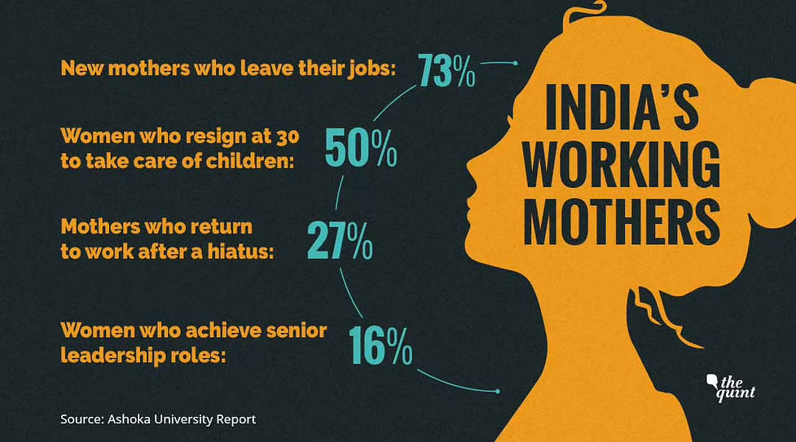
Statistics and Data

Slide 4
Outcome of research
We tried to dig more into data and research but there are timid datas about women in India. It seems people are not aware of what a tough period women go through after pregnancy or they don’t intend to think about it. Postpartum Depression(PPD) is very common among women, nearly about one in eight women. Some people who are not aware of this think that women don’t want to bear a child or are running away from their maternal duty. But in reality, women only need some help,care and support in order to pass such critical phase without falling into depression.
If tech becomes children’s nanny, it would be easier for working women.

Slide 5
Basic idea
1.We want to build an app that will connect mothers with babysitters of their choices and preferences to assist them in taking care of their child while they are at work.
2. There will be a dual login system where one can login either as a parent or as one willing to be a babysitter .
3. There will be a complete verification for both the parties including verification of their adhaar or any other photoidentity card , contact numbers, residential address and the like .
4.There will be options wherein the parents will have to fill in their specific requirements and qualities that parents want in the person who they will hire for taking care of their baby .

Slide 6
There will be a recommendation system setup where in after completing all the required formalities for setting up accounts, both the parties will get recommendations according to their choices.
There will be a system wherein parents can rate the babysitters and provide feedback for their services.
We will provide a package where we will provide fitbit and a feature to track their children.
All these features will be available to both the mother and father of child by logging in from their separate mobile phones so they both can be aware of their child.

Slide 7
The service providers will be required to click and upload images of child using the camera built in app after specific intervals to keep parents informed of their child.
The app will also be equipped with a gps system for parents to keep track of their child.
The parents as well as service providers will have the option of choosing from one of these services - babysitters, creches or stay at home mothers
The service provider can search for jobs based on a specific area or zip code
The app will also provide one time services where parents can take help if they for ex want to go to a party or some emergency situation arises where they need help.

Slide 8
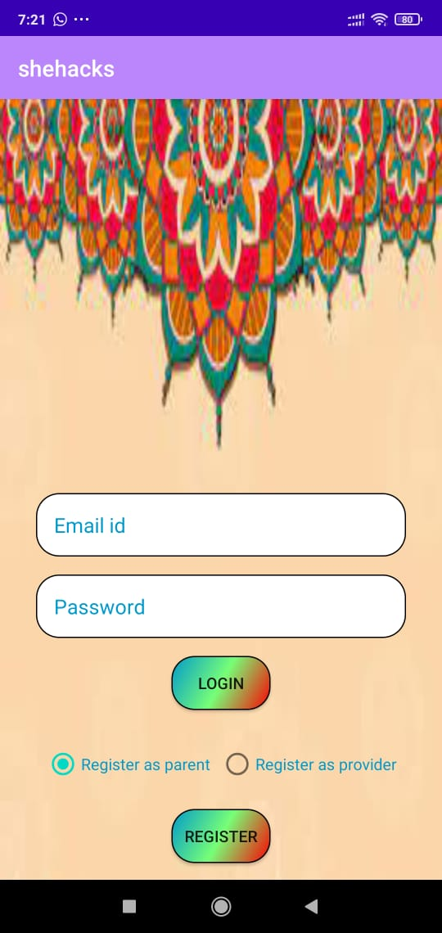

Slide 9
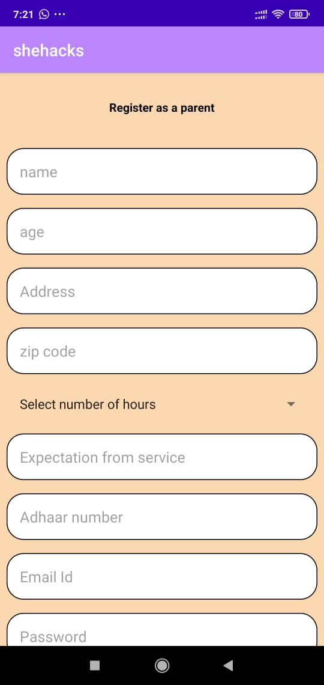

Slide 10
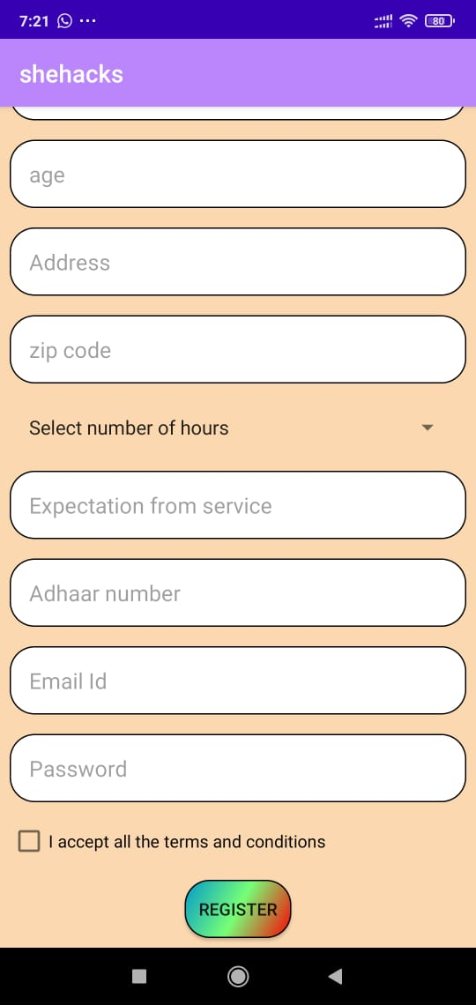

Slide 11
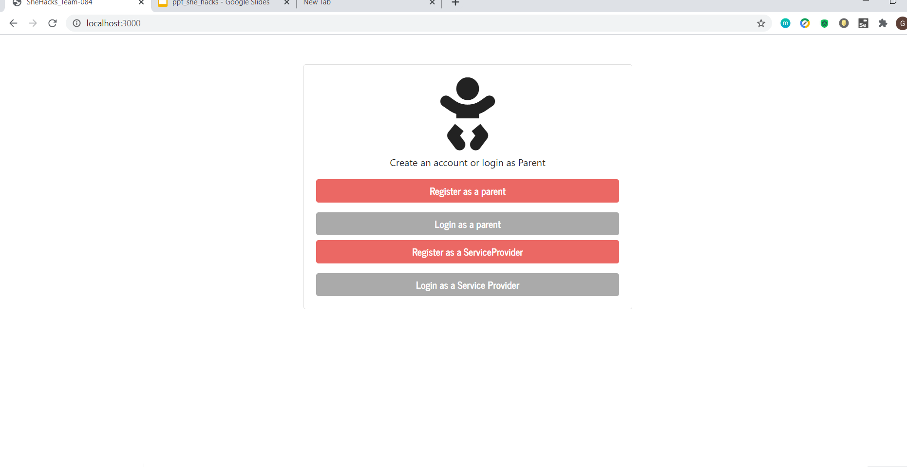

Slide 12
AFTER REGISTERING AS A PARENT :
YOUR NAME
AGE
IMAGE
RESIDENTIAL ADDRESS
ZIP CODE
NO OF HRS SERVICE EXPECTED
TIMINGS OF SERVICE
EXPECTATIONS FROM SERVICE PROVIDER(3 LINES)
UPLOAD ADHAAR/ANY PID
SPOUSE DETAILS :
NAME OF THE SPOUSE
CONTACT OF SPOUSE
EMAIL ID OF SPOUSE
CHILD DETAILS :
NAME
AGE
IMAGE
STANDARD
SPECIFIC TRAITS(3 LINES)
HOBBIES OF CHILD (3 LINES)
SELECT YOUR CHOICE (BABYSITTER , CRECH,STAY AT HOME SERVICE PROVIDER)
PROFILE OF PARENT COMPLETED

Slide 13
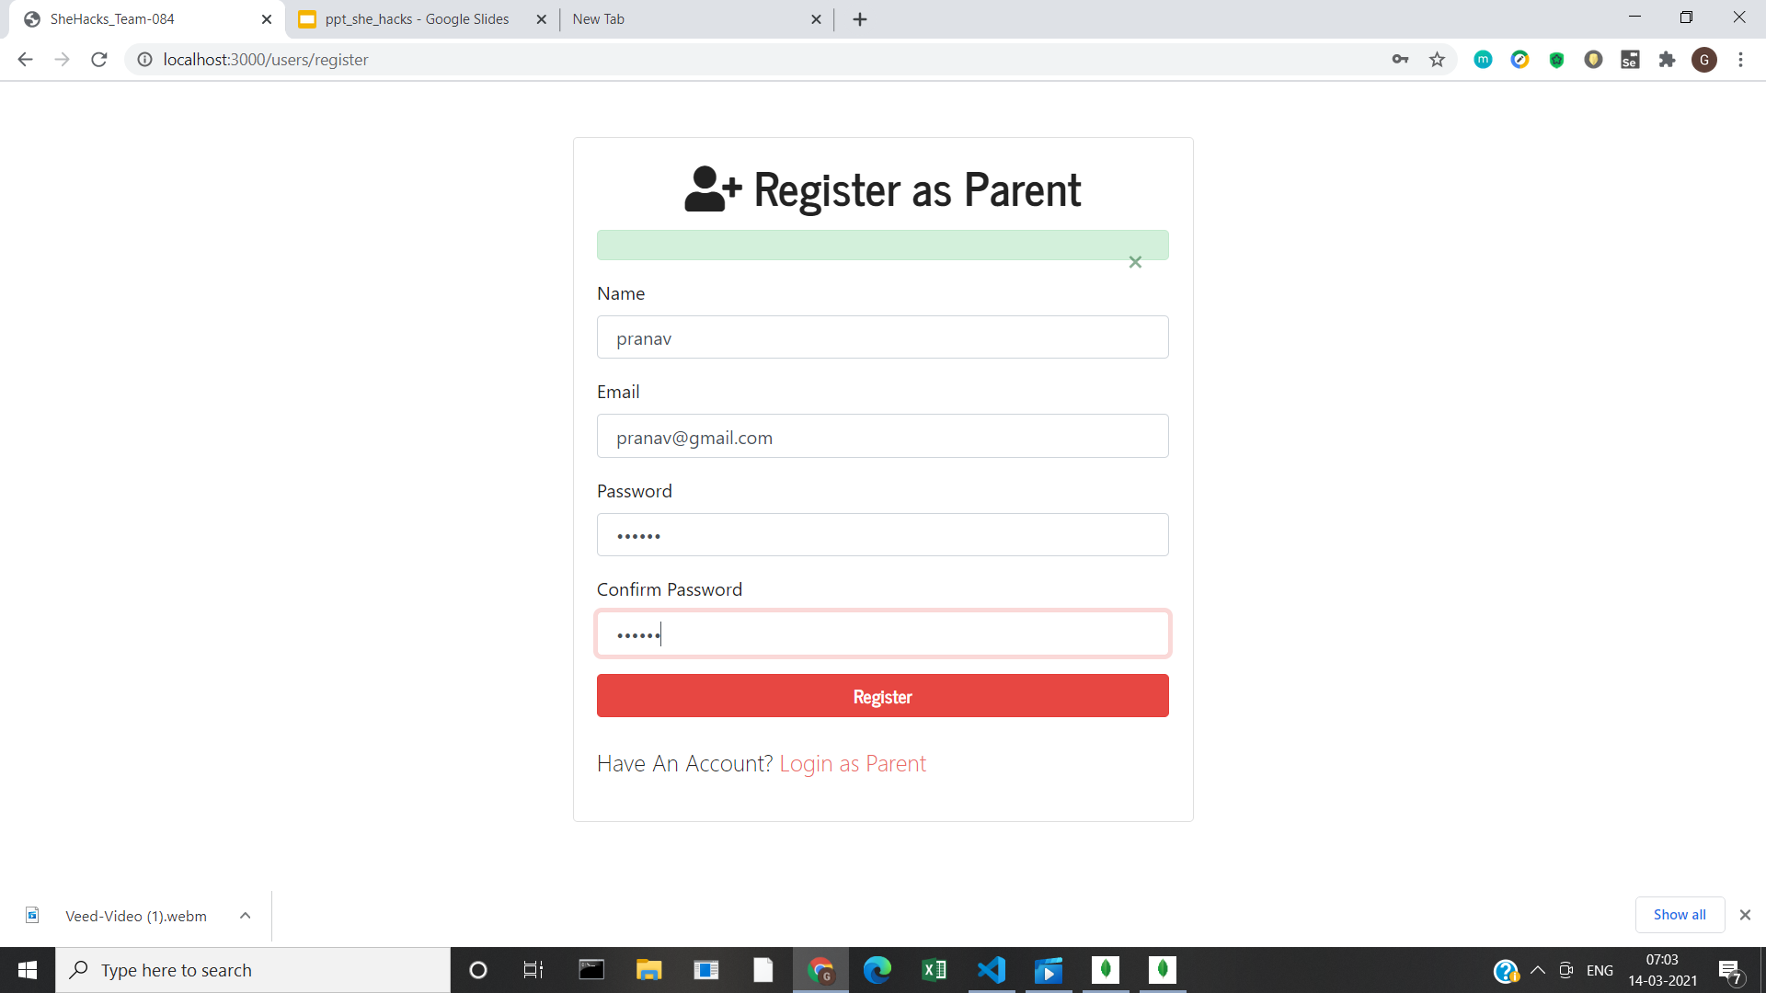

Slide 14
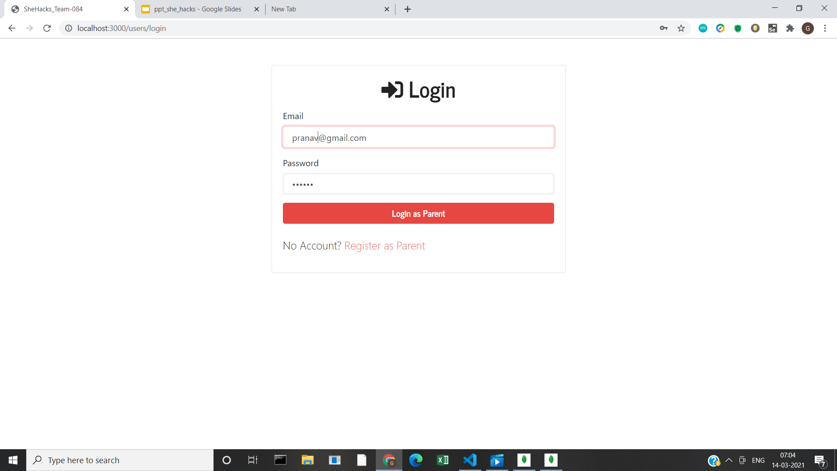

Slide 15
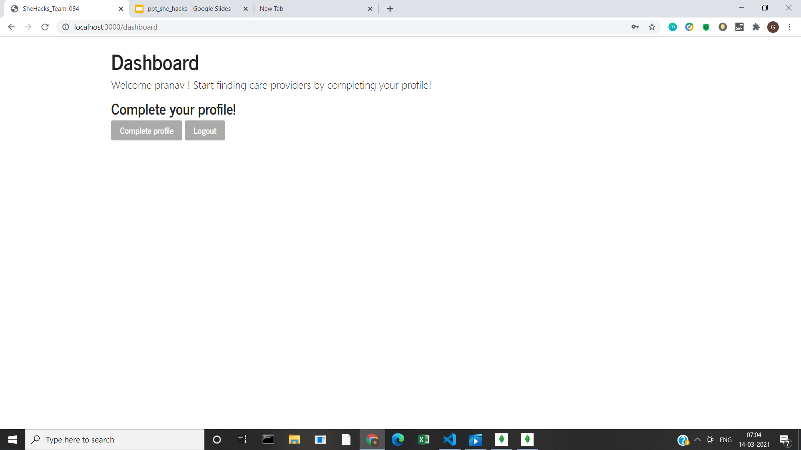

Slide 16
AFTER REGISTERING AS A SERVICE PROVIDER:
ALTERNATE NUMBER OF YOUR GUARDIAN
EXPERIENCE(IF ANY)
NO OF HRS YOU CAN GIVE
TIMINGS OF SERVICE
DISTANCE WILLING TO TRAVEL
WHY YOU WANT THIS JOB(3 LINES)
DESCRIBE YOURSELF IN 3 LINES
YOUR NAME
AGE
GENDER
IMAGE
RESIDENTIAL ADDRESS
ZIP CODE
UPLOAD ADHAAR/ANY PID
PROFILE OF SERVICE PROVIDER COMPLETED
SELECT YOUR CHOICE (BABYSITTER , CRECH,STAY AT HOME SERVICE PROVIDER)

Slide 17
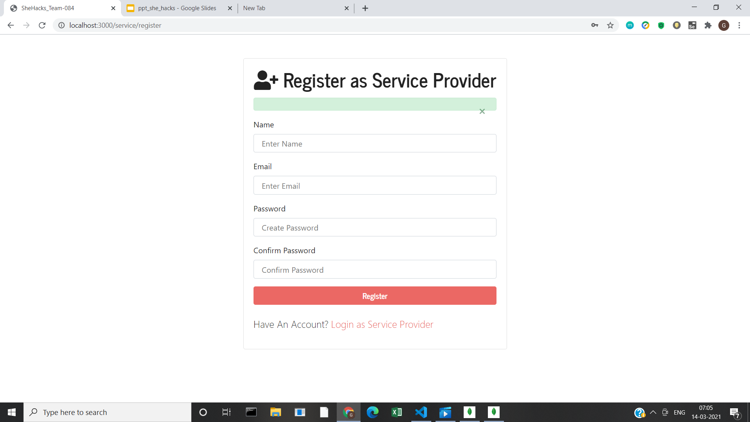

Slide 18


Slide 19
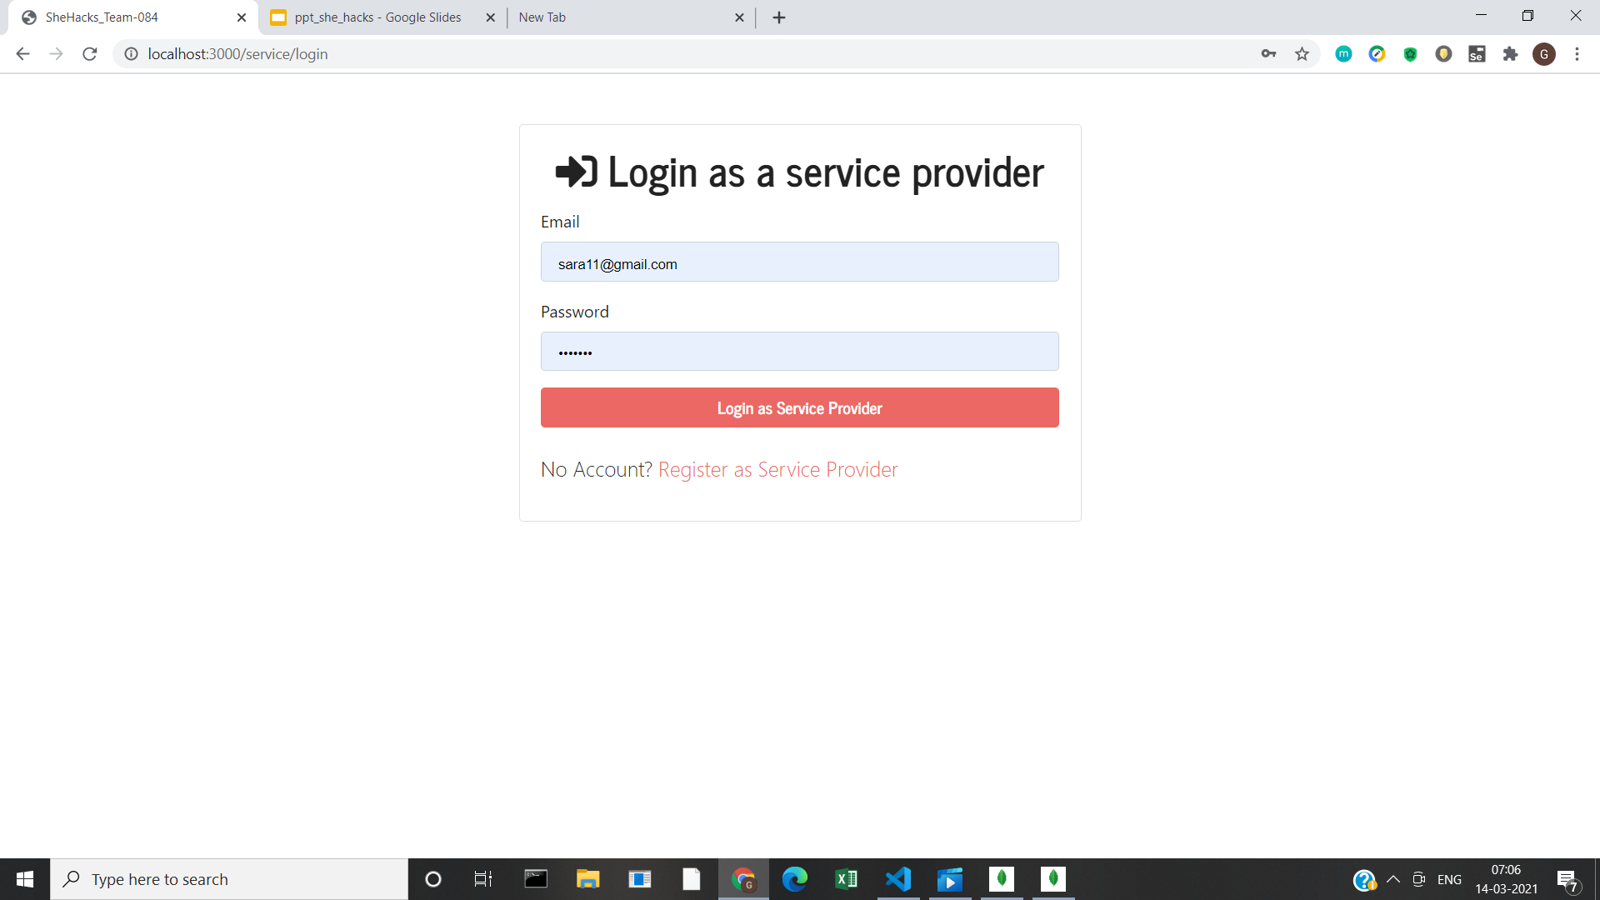

Slide 20
APPLICATIONS OF OUR PROJECT
This project aims to help and empower that section of women who have to sacrifice or compromise their career because of their children as they don’t have proper assistance in taking care of their child.
In today’s generation both of the parents are mostly working in urban areas and there is a problem of finding trustworthy people as babysitters. This project will help solve that problem.
Men and women both can be service providers and service requesters.
College students can also earn pocket money by working for this project.
This will help provide employment to a large number of people - especially people who are not so skilled otherwise.

Slide 21
FUTURE PROSPECTS
A payment feature can be incorporated which will replace the system of one-to-one payment and now payment will be regulated through the company based on area of service, hours of service provided and other conditions .
This will ensure a sense of security and answerability to both the parties involved.
Other features like shopping for baby products and baby food could also be added later.

Slide 22
THANK YOU!

